Slide 1
MCB 638
Live Session 5
Monday

Slide 2
Agenda for Live Session 5
Process Learnings
Tips
Chapter 9 Online Quiz review
Project Requirements and Scoring
Walk through sample projects
Sample Size and Confidence Intervals
Wrap-up/What’s next/Feedback

Slide 3
Process Learnings
Be sure to watch the Asynchronous material for each week before our Live Session. This week’s material is just 22 minutes long.
If any issues with LaunchPad, be sure to enable Flash and try another Browser. If still not working, contact LaunchPad support and get a ticket #. Please do this before the HW is due.
I will be posting Comments on 3.12 and 4.7 related to your projects.
Reminder to get the Understanding Variation book by Donald J Wheeler for upcoming work. This is required reading.

Slide 4
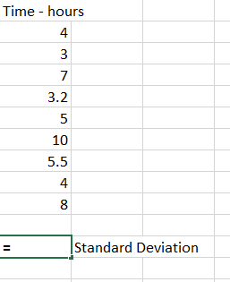
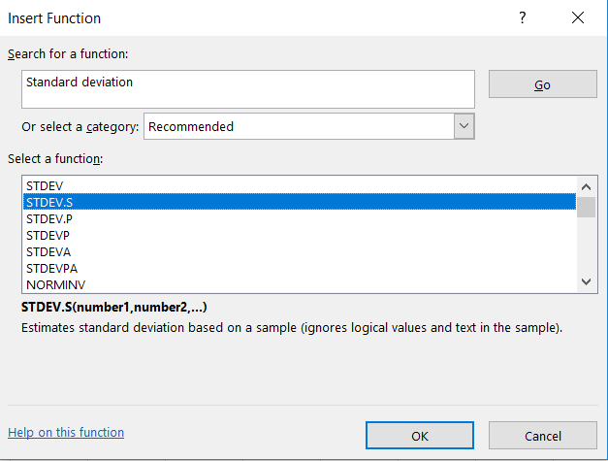
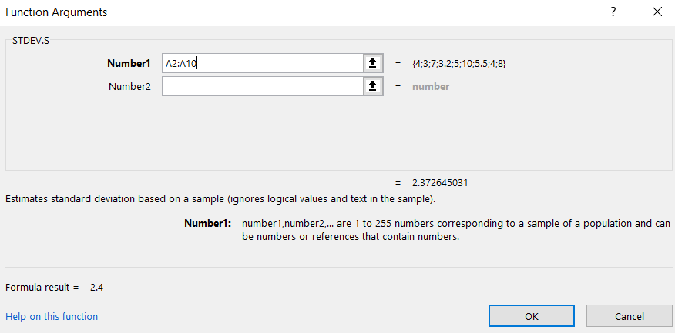
Tips
How do we get standard deviation?
Use Excel to calculate it from your data. Remember it is a measure of dispersion or spread.
Enter your data in one column
Click on an empty cell below your data
Click on fx in toolbar
Type in Standard Deviation in the Search box
Choose STDEV.S as this function will calculate standard deviation
based on a sample, which you will almost always have. Click OK.
In the pop-up box, your cursor will be in Number1. Highlight your data
and click OK. This will return the standard deviation of your data in the
blank cell you originally chose.

Slide 5
Tips continued
Are there more practice problems?
Yes – In LaunchPad, under ‘Assignments’, you will see ‘Unassigned’.
You can utilize these resources.
-Also, ‘Additional problems’ is posted in class Files
- Also, consider the problems in the back of each chapter in your book.
Note: Excel problems from Asynchronous material are posted under Files as “Data_sets_Excel_async_examples”

Slide 6
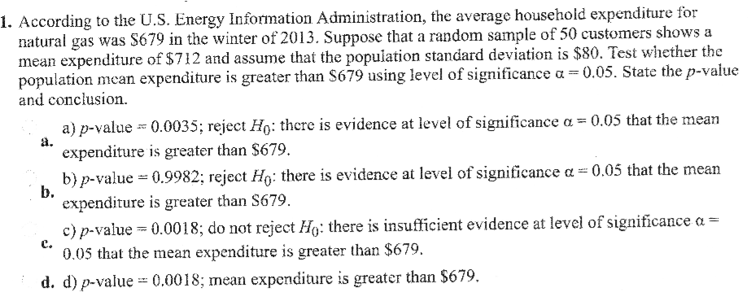
Chapter 9 Online Quiz Review
From Table C:
p=.9982
Therefore 99.82% of the data is below
712, and 1-.9982, or .0018 is above 712
So p = .0018 is low (lower than alpha of .05)
So p is low, Ho must go
Ho is there is no difference, so since this must
go away, we find that there is a difference!
Z= 712-679
-----------
80/SQRT(50)
Z= 33
-----
80/7.07
Z= 33/11.32 = 2.92
Ho: Mu=679
Ha: Mu>679
Alpha = .05
Z= X bar – Mu
---------------
s/SQRT(n)

Slide 7
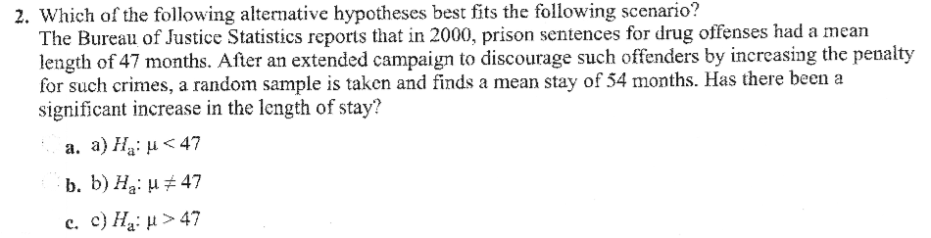
Chapter 9 Online Quiz Review - continued

Slide 8
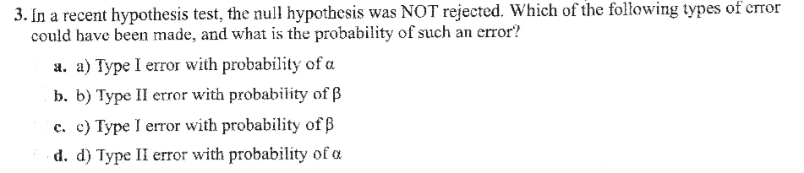
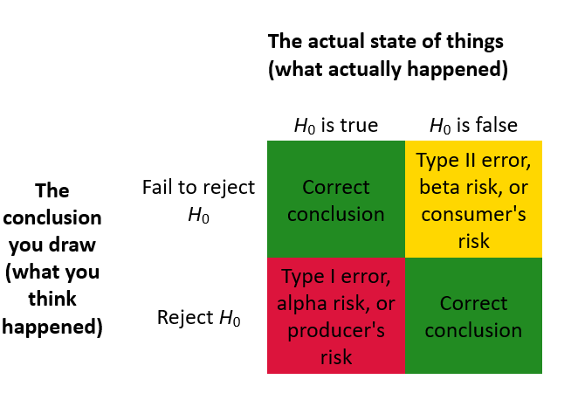
Chapter 9 Online Quiz Review - Continued
Answer: ?

Slide 9
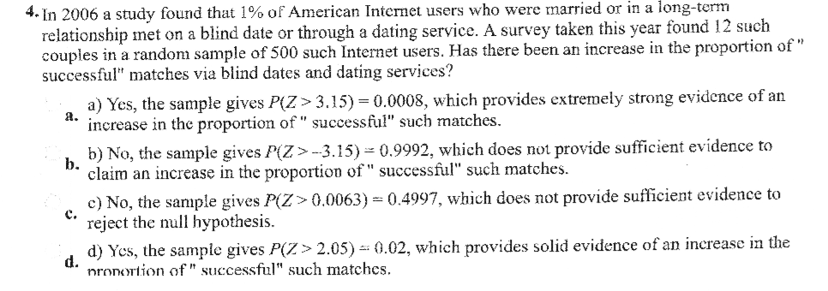
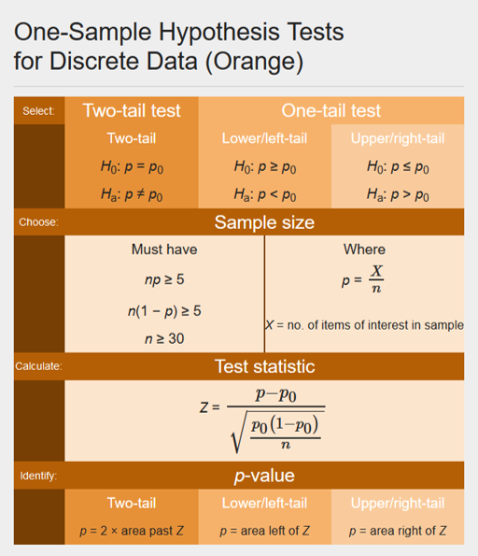
Chapter 9 Online Quiz Review – Continued
Ho: p=.01
Ha: p>.01
12/500 = .024
Z= p-po
---------------
SQRT(po(1-po)/n)
Z= .024-.01
-----------
SQRT (.01*(1-.01)/500)
Z= .014
-------
.00445
Z= 3.146 p=.9992
99.92% of data is to the
left of this point
Therefore p = .0008 is to the
right of .024
P is low at .0008, so Ho
must go, so there is an
increase in the proportion

Slide 10
Process Improvement Project –Requirements
The final submission should be 1 file, in slide format, created in PowerPoint. It should include 2 parts:
An executive summary slide – this will be a 1 slide Storyboard (details below).
The project itself will then be presented in detail in 5-15 slides following the storyboard. (include requirements listed on next page).
Executive Summary : Storyboard (should be presented in 1 PowerPoint slide)
Include the problem statement and baseline
Follow the DMAIC steps. Present several different tools/techniques
Be readable; summarize and condense exhibits where necessary
Use arrows, call out boxes, and balloons to highlight questions and key learnings
Display data/charts supporting your findings and conclusions. Show results or expected results

Slide 11
2.) On PowerPoint slides following the Storyboard include:
Data measurement plan or data stratification tree
SQL calculations for old and maybe new process
And answer the following questions:
• What type of data did you collect (cost, cycle time, changeover time, yield, machine utilization, scrap, rework, defects, inventory)?
• Was that data continuous or discrete?
• Have clear operational definitions been established for your inputs and outputs?
• Did you collect your own data, or did you use existing data?
• How much data did you collect and why? What is your ideal sample size using the sample size formula? What is the risk if you collected fewer samples?
• How was your data collected? Describe the methods you used to collect it.
• Where could you have measurement error? How much measurement error do you have? What could you do to minimize your measurement error?
• What is the data telling you? What did you discover?
• What solutions did you propose and/or implement? Did you successfully improve your process? What did you learn about your process?

Slide 12
Process Improvement Project Rubric
A) An executive summary is provided in the storyboard format including: Is the storyboard presented in 1 PowerPoint slide? Follows DMAIC? Are tools/graphs/charts used and clearly visible? Do they support findings and conclusions Are arrows, call-out boxes, etc. used to summarize, highlight questions and key learnings? Are expected results clear? And next steps noted? | 5
B)Is it a cohesive presentation opening with the business process and problem statement? The back-up slides (5-15) detail and support the storyboard content. | 2
C) Was the success measure clearly identified, operationally defined and baseline identified? (Was the data identified as continuous or discrete, includes SQL?) | 3
D) Was the data measurement plan or data stratification tree included? | 1
E) Was the data collection method identified? | 1
F) Was there rationale for the sample size taken? Use of the formula? Is there any reference to measurement error and how to minimize? | 1
G) Are at least 5 different tools and techniques clearly identified? Are the tools linked/ pertinent to the data analysis? | 5
H) Does the data analysis clearly tie to the problem conclusion? Is the “discovery” clear to the reader? | 2
Total possible
points = 20

Slide 13
Projects – List of Tools
Data Analysis Tools
Excerpt:
Tool | What is it? | When do I use it? | Example | DMAIC
Affinity Diagram | A method to gather and organize brainstormed ideas (language data) into groupings based on the natural relationship between items. | When you need to organize and consolidate large amounts of qualitative data in order to support a concept or solution. | http://en.wikipedia.org/wiki/Affinity_diagram | Measure, Analyze, Improve, Control
Box and Whisker Plot | A graphical way to compare the medians and the variation between groups of data. It can also help to identify outliers. | When you need a quick visual look at one or more sets of data. They graphically show different types of populations without any assumptions of the statistical distribution. | Discovering Stats – pg.138-141 | Measure, Analyze, Improve
Cause and Effect / Fishbone / Ishikawa Diagram | A structured problem solving technique that graphically displays / organize all possible brainstormed causes relating to a problem (focusing on causes, not symptoms). | When you have a large number of factors that could influence your process and you need support for a resulting solution. | Slides posted in Course Materials | Analyze
Check Sheets | Used for counting and accumulating data in a logical format during observation. This is a straightforward and easy way to answer the question, how often are certain events happening? | When quantifying frequency / counting data on number of occurrences (eg. defects), information on variables (eg. weight, size, length, or defect location, etc.). | http://web2.concordia.ca/Quality/tools/6cksheet.pdf | Measure
Chi-Square – Test for Independence | This is a procedure used to determine if two classifications variables are related, testing the statistical independence of two random variables. It compares the number of observed counts against the expected number of counts to determine if there is a difference in output counts. | It is a good method to apply to before and after data to prove that a process improvement made an effective change. Use this method when you have nominal data in a table and you need to know if the output counts differ for two or more categories. | Discovering Stats – pg. 570-571 | Analyze, Improve
See 5-page full list in Files “Improvement_Tools_list_wDMAIC.doc”

Slide 14
Walk through sample projects
Strengths
Weaknesses

Slide 15
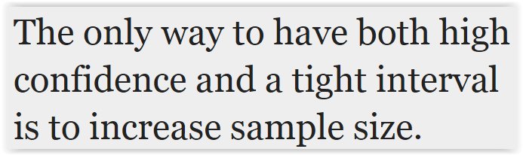
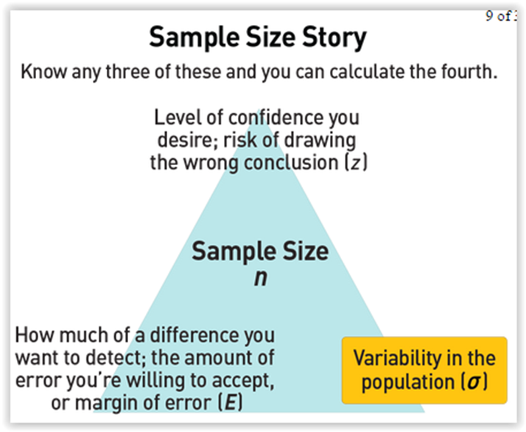
Sample Size

Slide 16


Sample Size – Continuous Data
Sample size for estimating the population mean:
n = (z* x sample std. dev)
----------------------------
E
Formula is more precise than using n = 30 for all continuous data problems
E = Margin of Error – the shift in the mean that you want to be able to detect
Margin of Error is not the same as Measurement Error

Slide 17
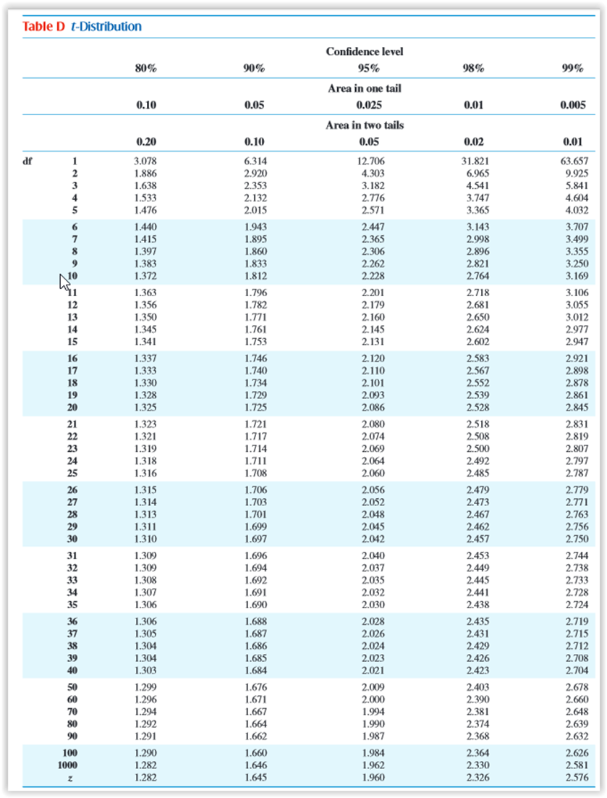
Finding z*
Confidence
level
z* →

Slide 18

Sample Size – Continuous Data
Suppose we want to estimate to within $100 the mean salary mu of all college graduates who were business majors. Assume std. dev = $5000. How many business majors would we need to sample to estimate the mean salary to within $100 with 95% confidence?
n = ((z* x std. dev)/E)²
Find z* in Table D on bottom: For 95% confidence level, z* = 1.96
n =((1.96 x 5000)/ 100)²
n = 9604
What if you want to estimate within $1000 (willing to detect a larger shift)?
n = ((1.96 x 5000)/1000)² = 96.04 = 97

Slide 19
Next step for your project
Use the appropriate formula to calculate your minimum required sample size

Slide 20
Confidence Interval
We are drawing a conclusion about a population parameter based on a sample.
We can use a Confidence Interval to say that we are XX% confident that a population mean is between two levels.

Slide 21
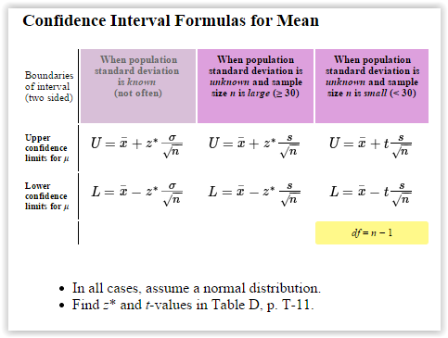
Confidence Interval – Continuous Data
Formula to use depends on population standard deviation and sample size:

Slide 22

Confidence Interval – Continuous Data
A Confidence Interval is a range of values from the sample data in which we expect the population parameter to occur
For n>=30: (Note: If n<30, use the t distribution instead of z*)
Lower confidence limit and upper confidence limit =
X +/- z*x s
n
The College Board reports that the scores on the SAT Math test were normally distributed. A sample of 30 SAT scores had a mean of x = 510. Assume that the population standard deviation is 118. Construct a 95% confidence interval for the population mean score on the SAT math test.

Slide 23
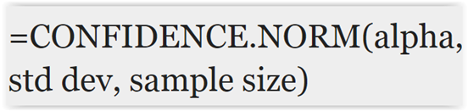
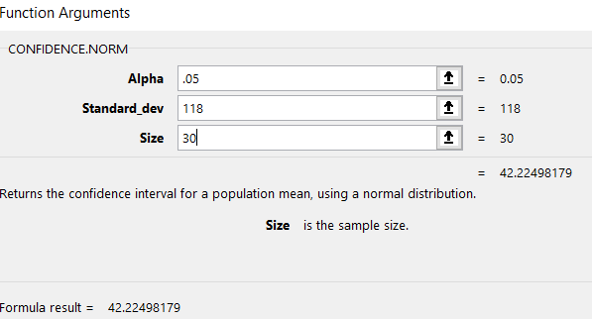

Confidence Interval – Continuous Data
Or, in Excel:
z* for 95% confidence = 1.96
510 +/- (1.96)(118)
---------------
30
510 +/- 231.28
---------
5.48
510 +/- 42.2
Confidence Interval: 467.8, 552.2
We are 95% confident that the population mean score on the Math SAT falls between 467.8 and 552.2

Slide 24
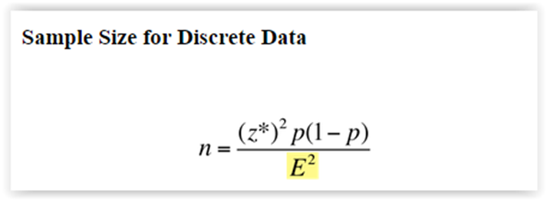
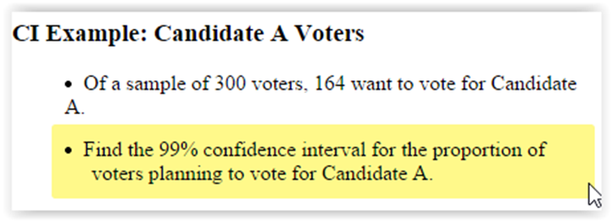
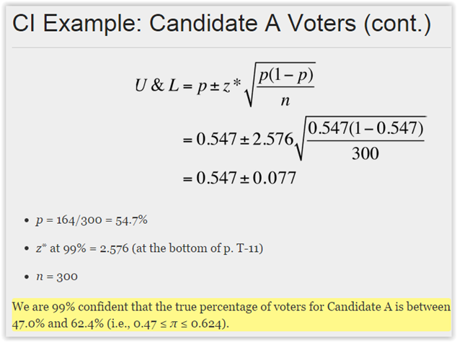
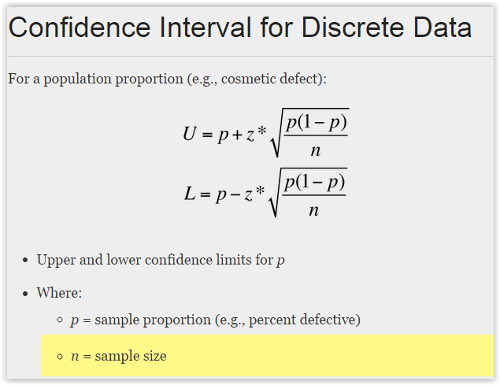
Sample Size and Confidence Interval for Discrete Data
This is more precise than using n = 100

Slide 25
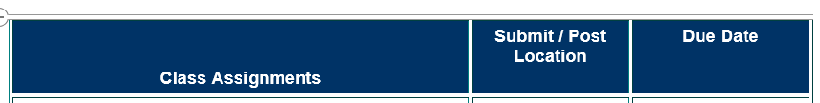
What’s next
Week 5 (Reference: textbook Ch.8 – skip sect. 8.4)
Homework #3: (worth 2 points) LaunchPad Assignments Chapter 8 Practice Quiz (unlimited attempts) | LaunchPad | 3 days after Live Session 5 = Nov 5
Week 6
Quiz #2 (covers Chapters 3,6,8,9,11.2) | Coursework → Assessments | 3 days after Live Session 6 = Nov 12
Project – Determine your sample size
- Analyze/Improve Phase
- Begin to outline and create your PowerPoint
Next week – Class - Prep for Quiz 2

Slide 26
Questions?

